Slide 1
MERRY TRAIN

Slide 2
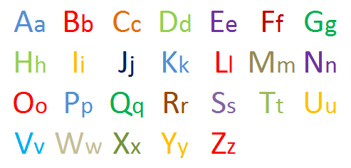

Slide 3
Read The Sounds [w] [h] [n] [r] [g] [i:] [ɔ:] [j] [t] [l]

Slide 4
Read The Sounds [d] [s] [ɔ:] [k] [m] [f] [dʒ] [θ] [ɛə] [ɑɪ]

Slide 5
Read The Sounds [b] [i] [tʃ] [dʒ] [ʌ] [ɪə] [ʒ] [ɔɪ] [v] [ʊ]

Slide 6
Read The Sounds [z] [ʊə] [ʃ] [ɒ] [ð] [eɪ] [p] [ə] [ ŋ ] [ɜ:]

Slide 7
Read the words
/'dɑ:ns/ /'desk/ /'ɪə/
/'grændfɑ:ðə//'hæpɪ/

Slide 8
Read the words
/'haʊs//'mʌŋkɪ//'pɑ:k/
/'kwi:n//'redɪ/

Slide 9
Read the words
/'bæg/ /leɪzɪ/ /'bɔ:l/ /'æpəl/ /'brʌðə/

Slide 10
Соедините слово и транскрипцию match the word and its transcription
сlock [hɔ:s]
lamp [kæt]
flag [læmp]
cat [flæg]
horse [klɔk]

Slide 11
Соедините слово и транскрипцию
match the word and its transcription
box [fiʃ]
duck [dɔg]
dog [bɒks]
rabbit [dʌk] fish ['ræbit]

Slide 12
Соедините слово и транскрипцию match the word and its transcription brown [pju:pl] book [hen] red [braun] pupil [red] hen ['buk]

Slide 13
Соедините слово и транскрипцию match the word and its transcription bag [waɪt] pet ['elɪfənt] elephant [gri:n] green [pet] white [bæg]

Slide 14
Соедините слово и транскрипцию match the word and its transcription pig [fɔks] giraffe [sneɪk] snake ['ɔrɪnʤ] fox [pɪg] orange [ʤɪ'rɑ:f]

Slide 15
4 | 7 | 10 | 8 | 1
3 | 9 | 6 | 2 | 5

Slide 16
5 | 10 | 6 | 8 | 1
2 | 7 | 3 | 9 | 4

Slide 17
6 | 9 | 3 | 7 | 4
1 | 8 | 5 | 10 | 2

Slide 18
Make up a correct sentence
Uncle John, books, read, likes, to

Slide 19
Make up a correct sentence
Uncle John likes to read books.

Slide 20
Make up a correct sentence
The ball, play, with, I, can?

Slide 21
Make up a correct sentence
Can I play with the ball?

Slide 22
Make up a correct sentence
Does, my, like, not, read, brother, to, little, books.

Slide 23
Make up a correct sentence
My little brother does not like to read books.

Slide 24
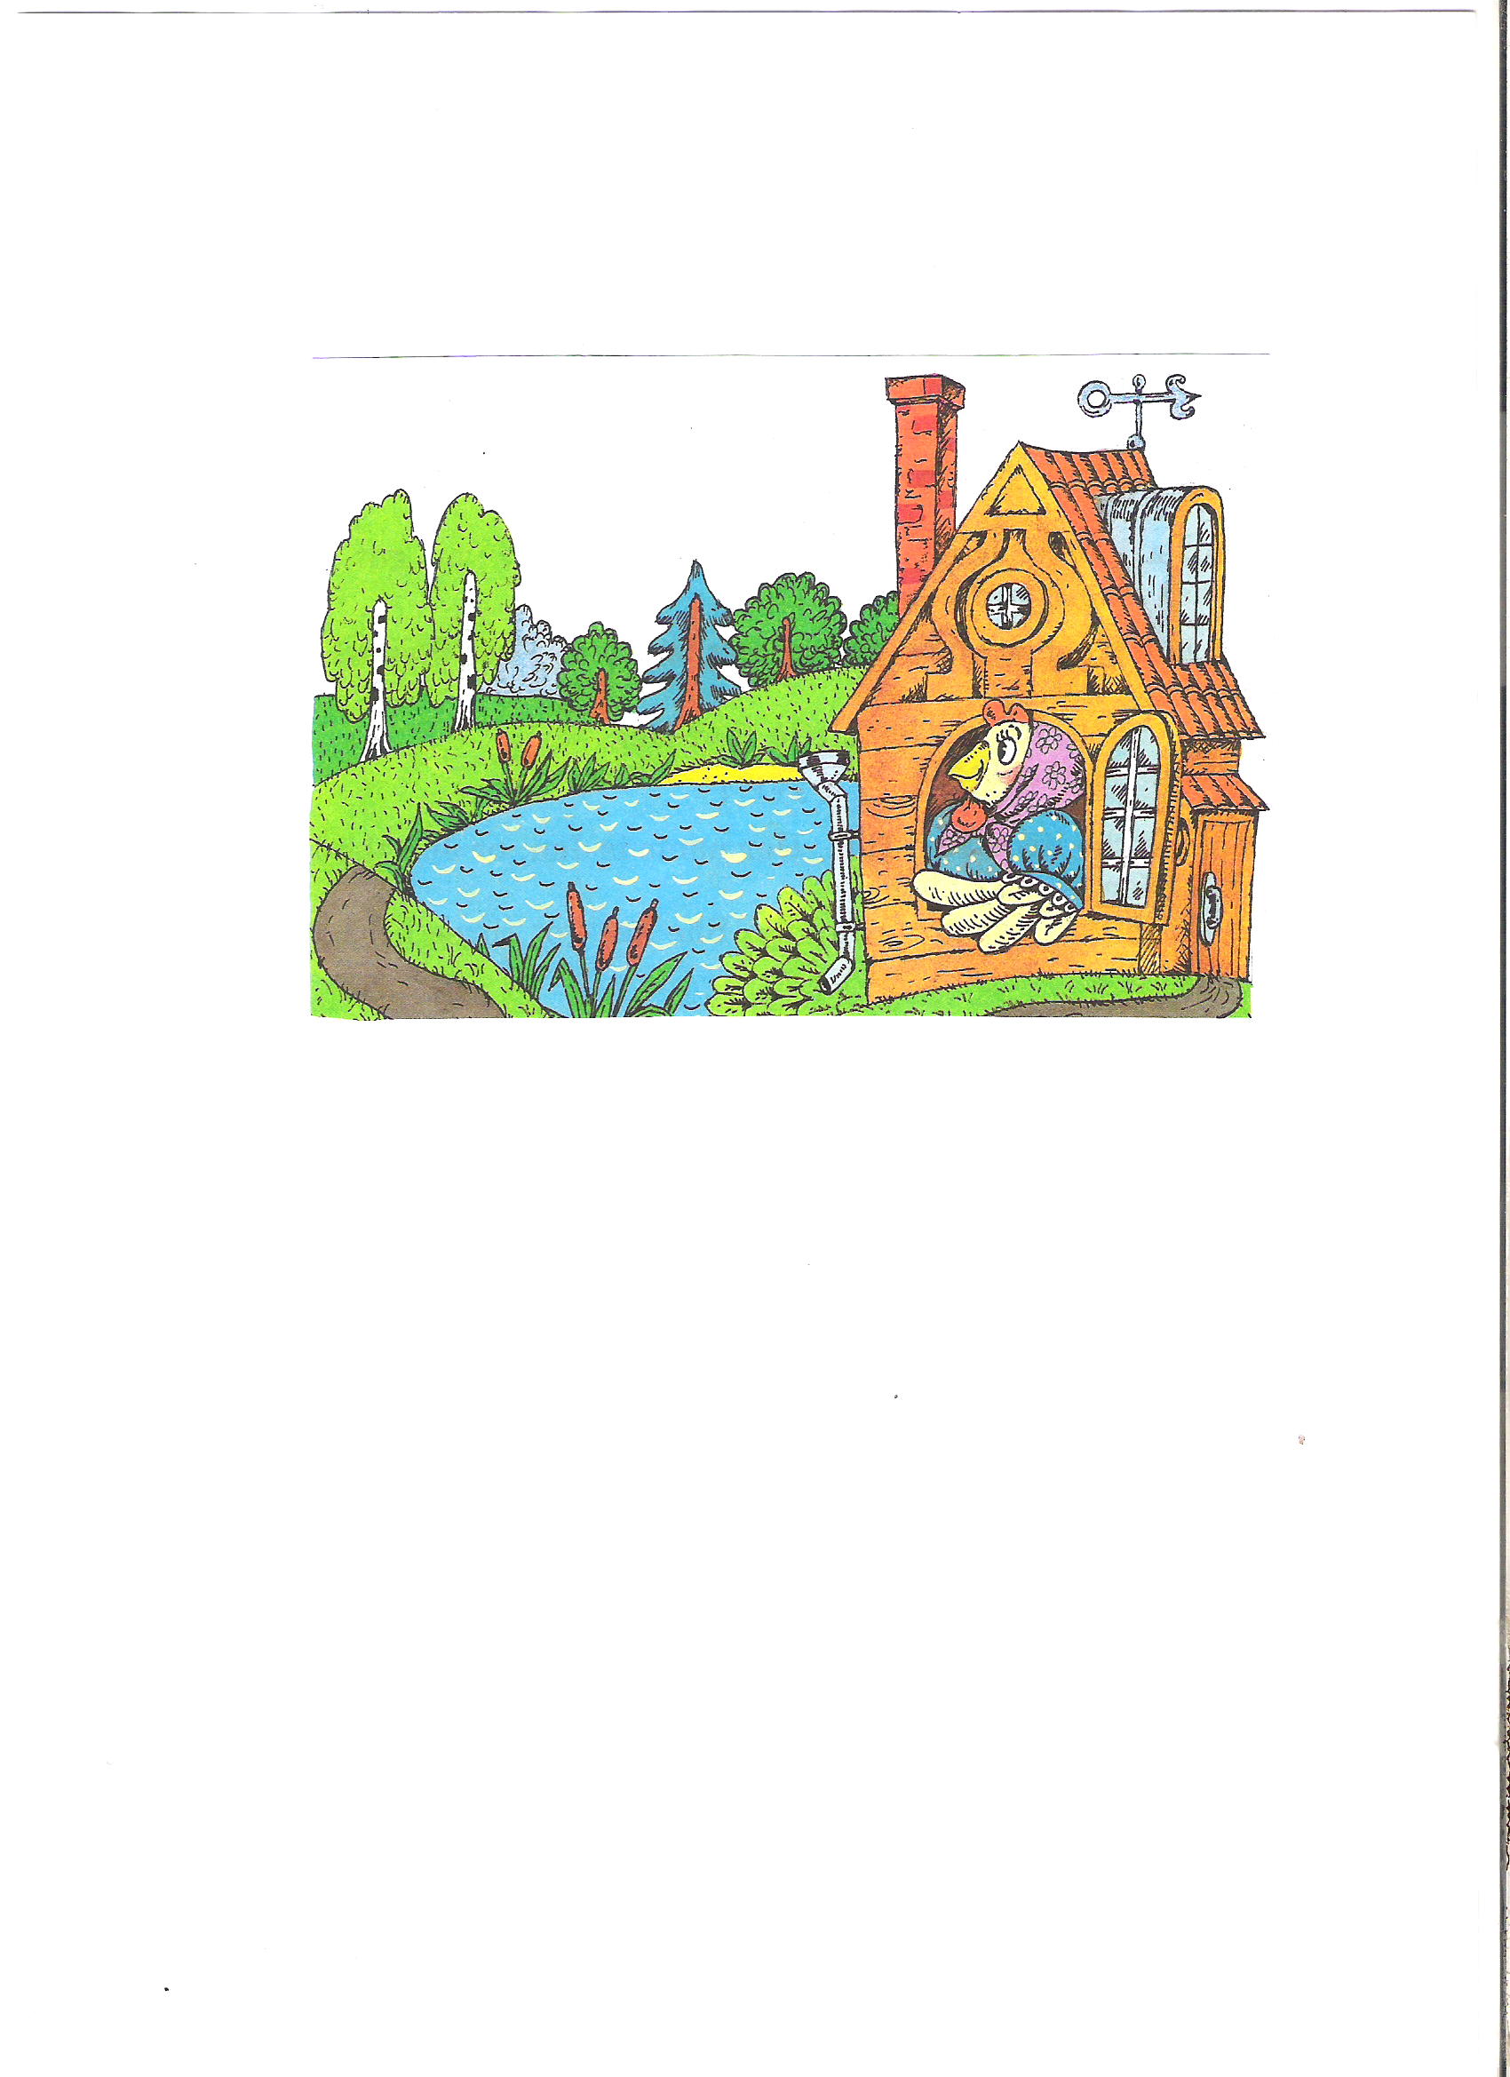
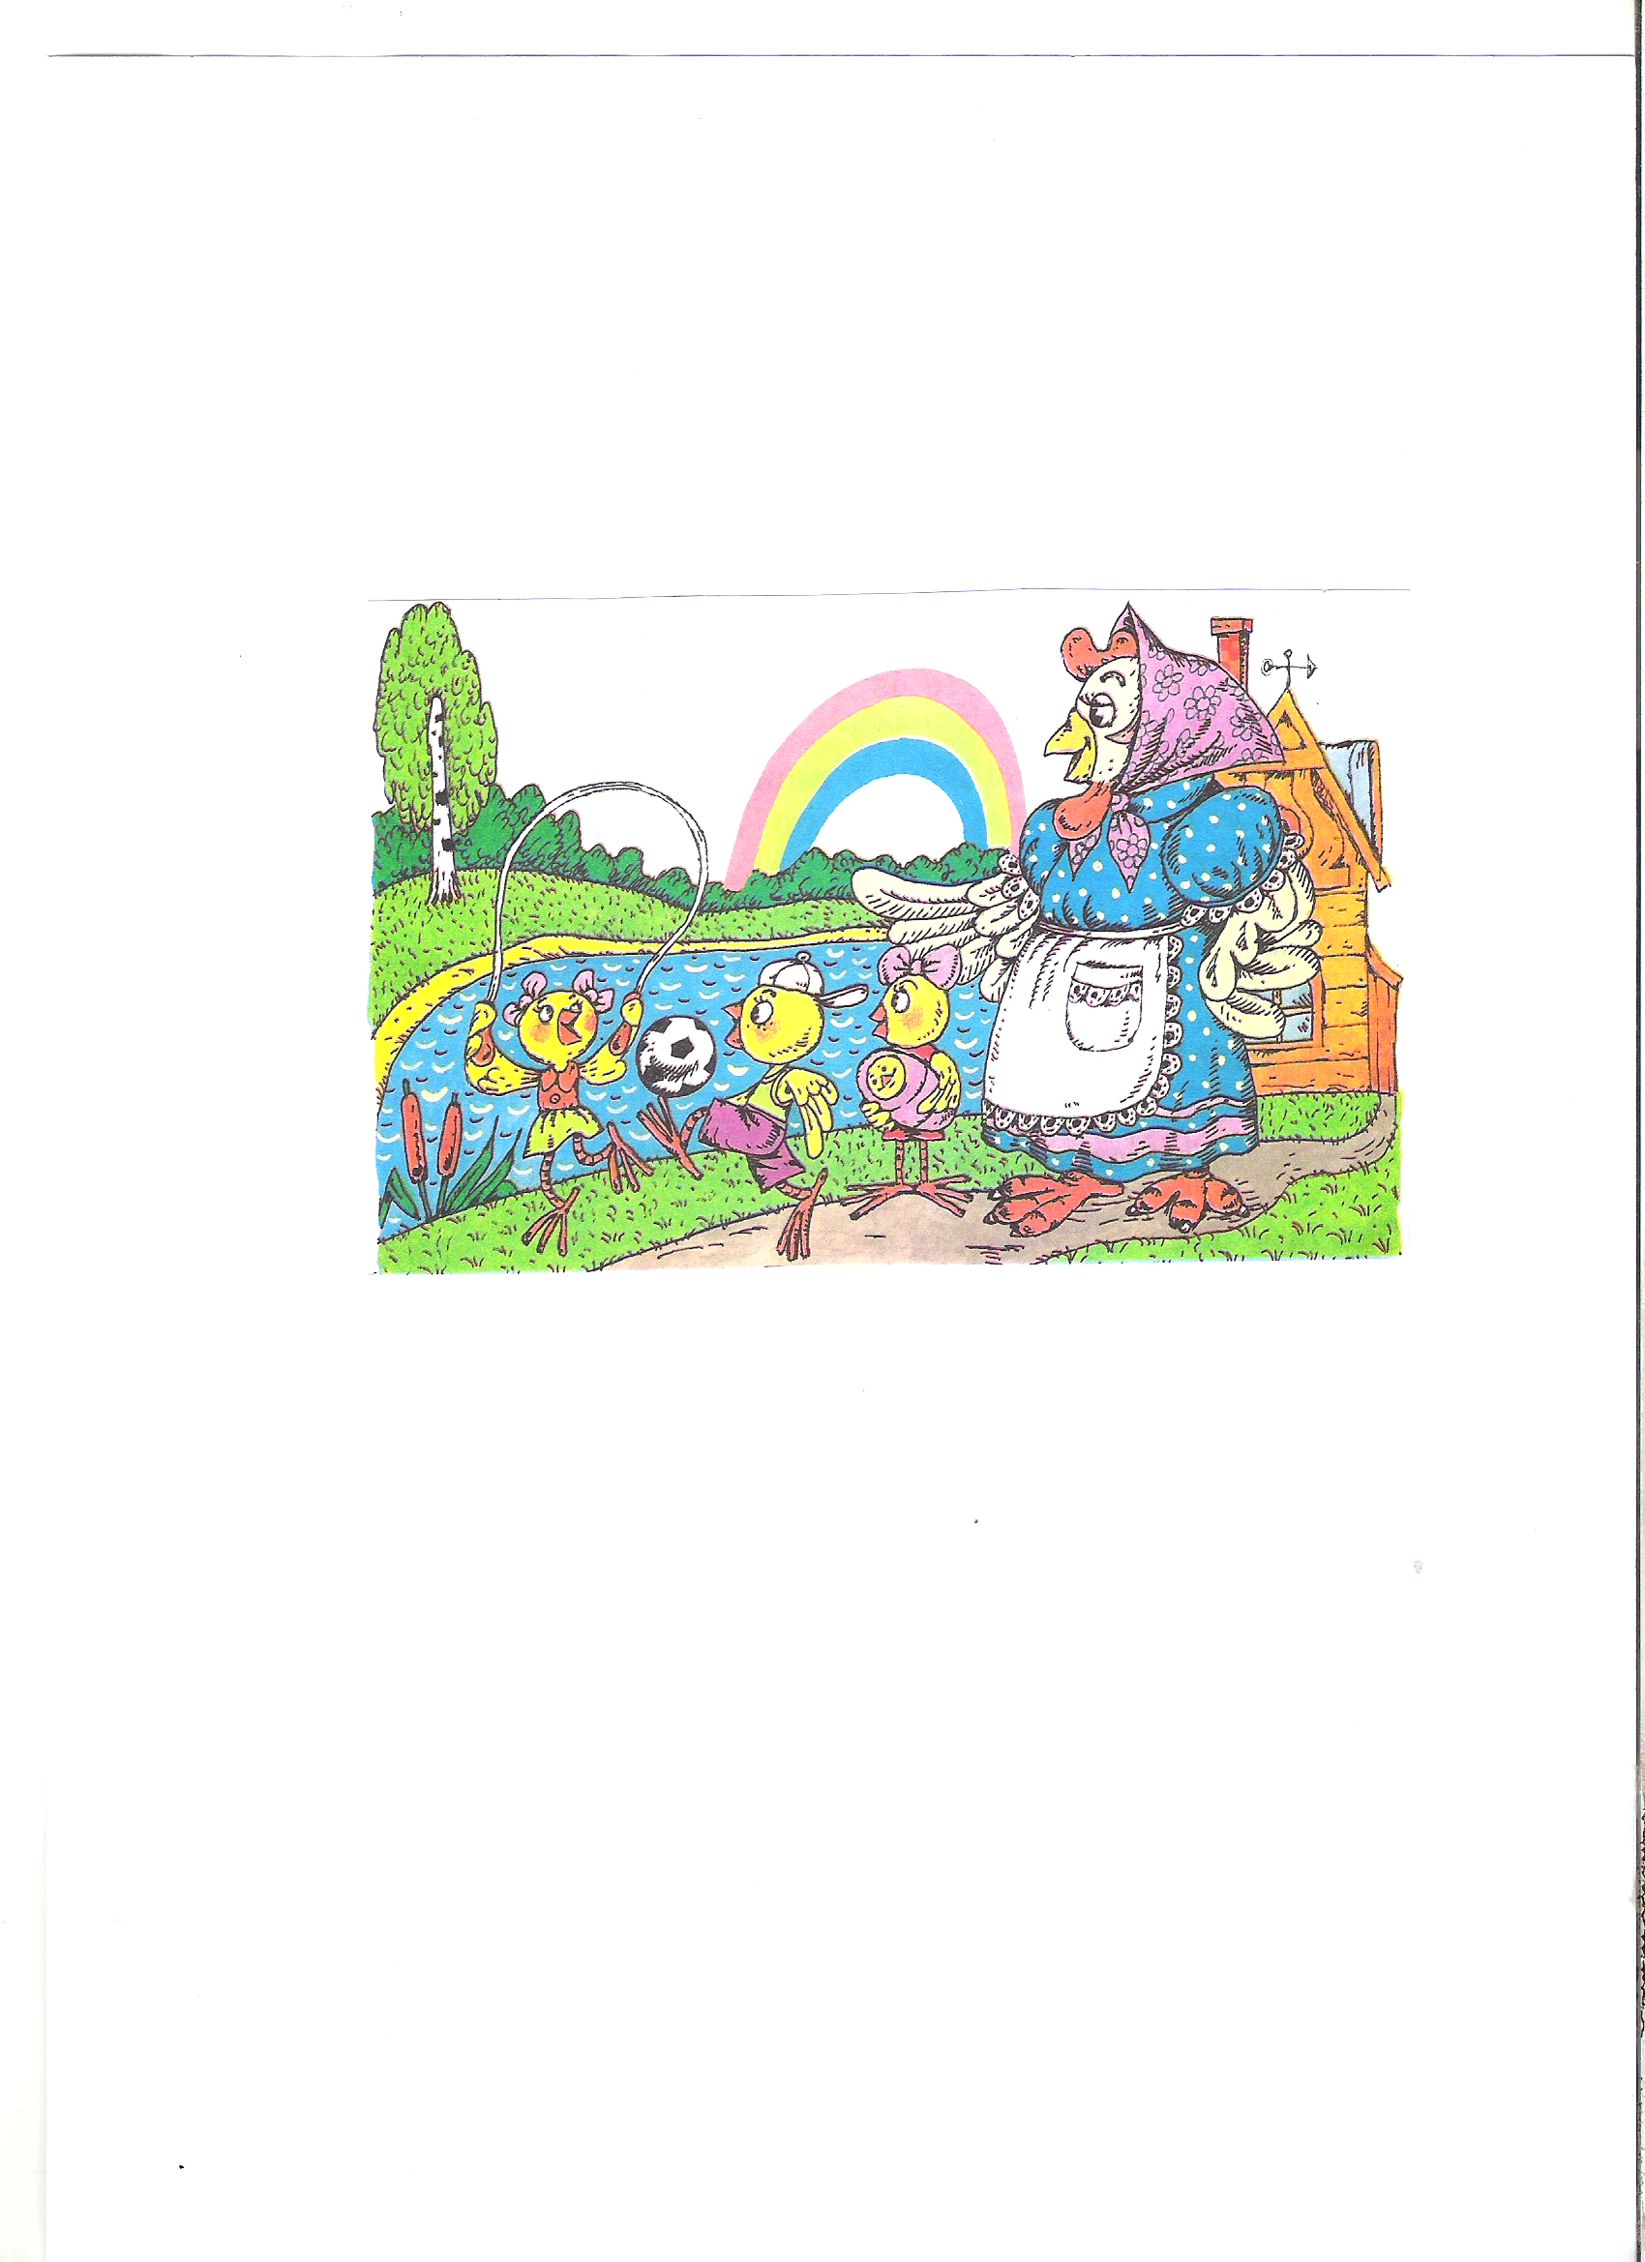
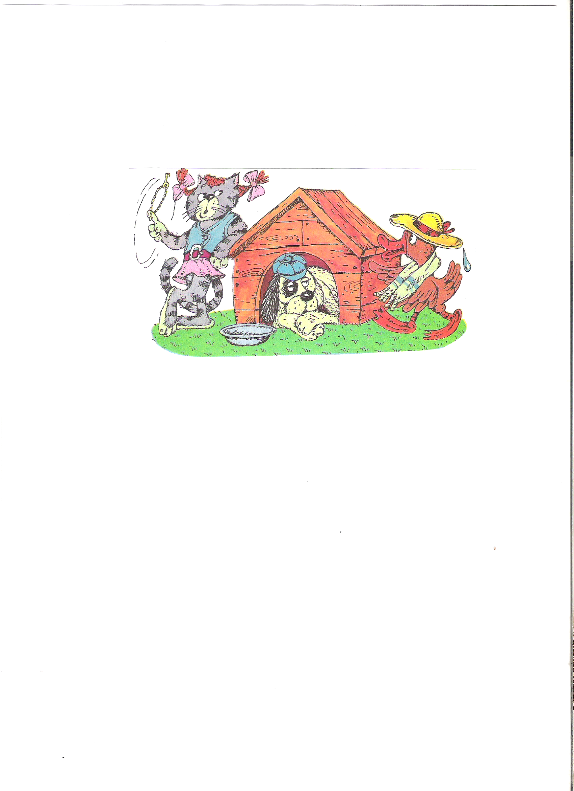
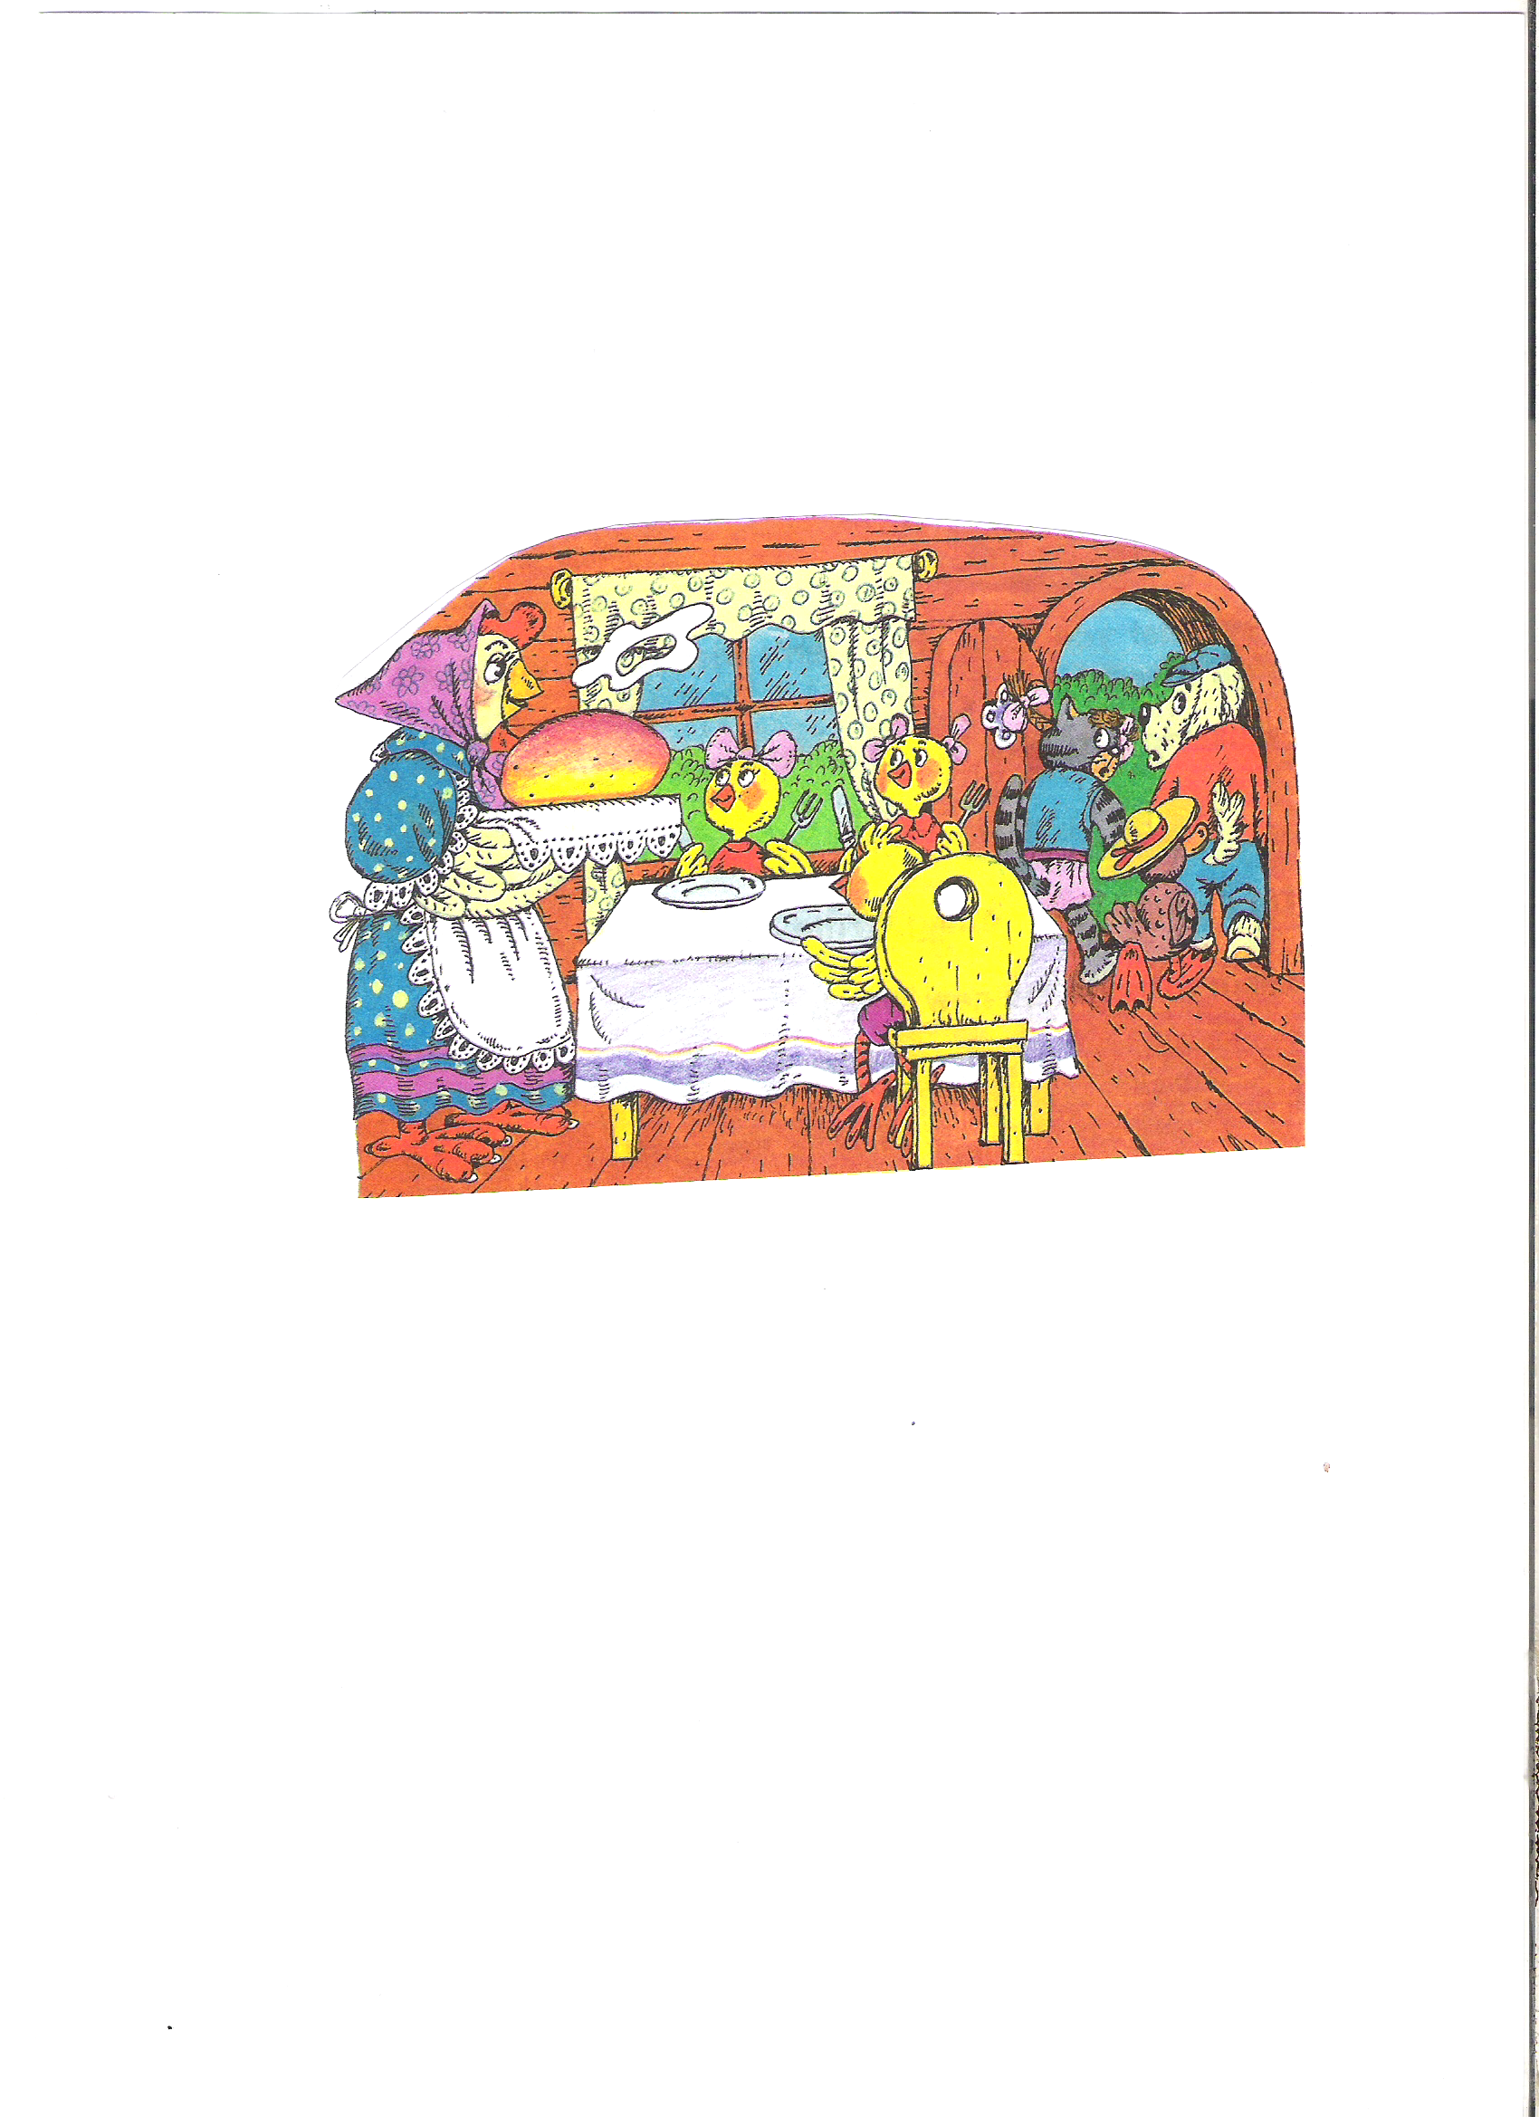
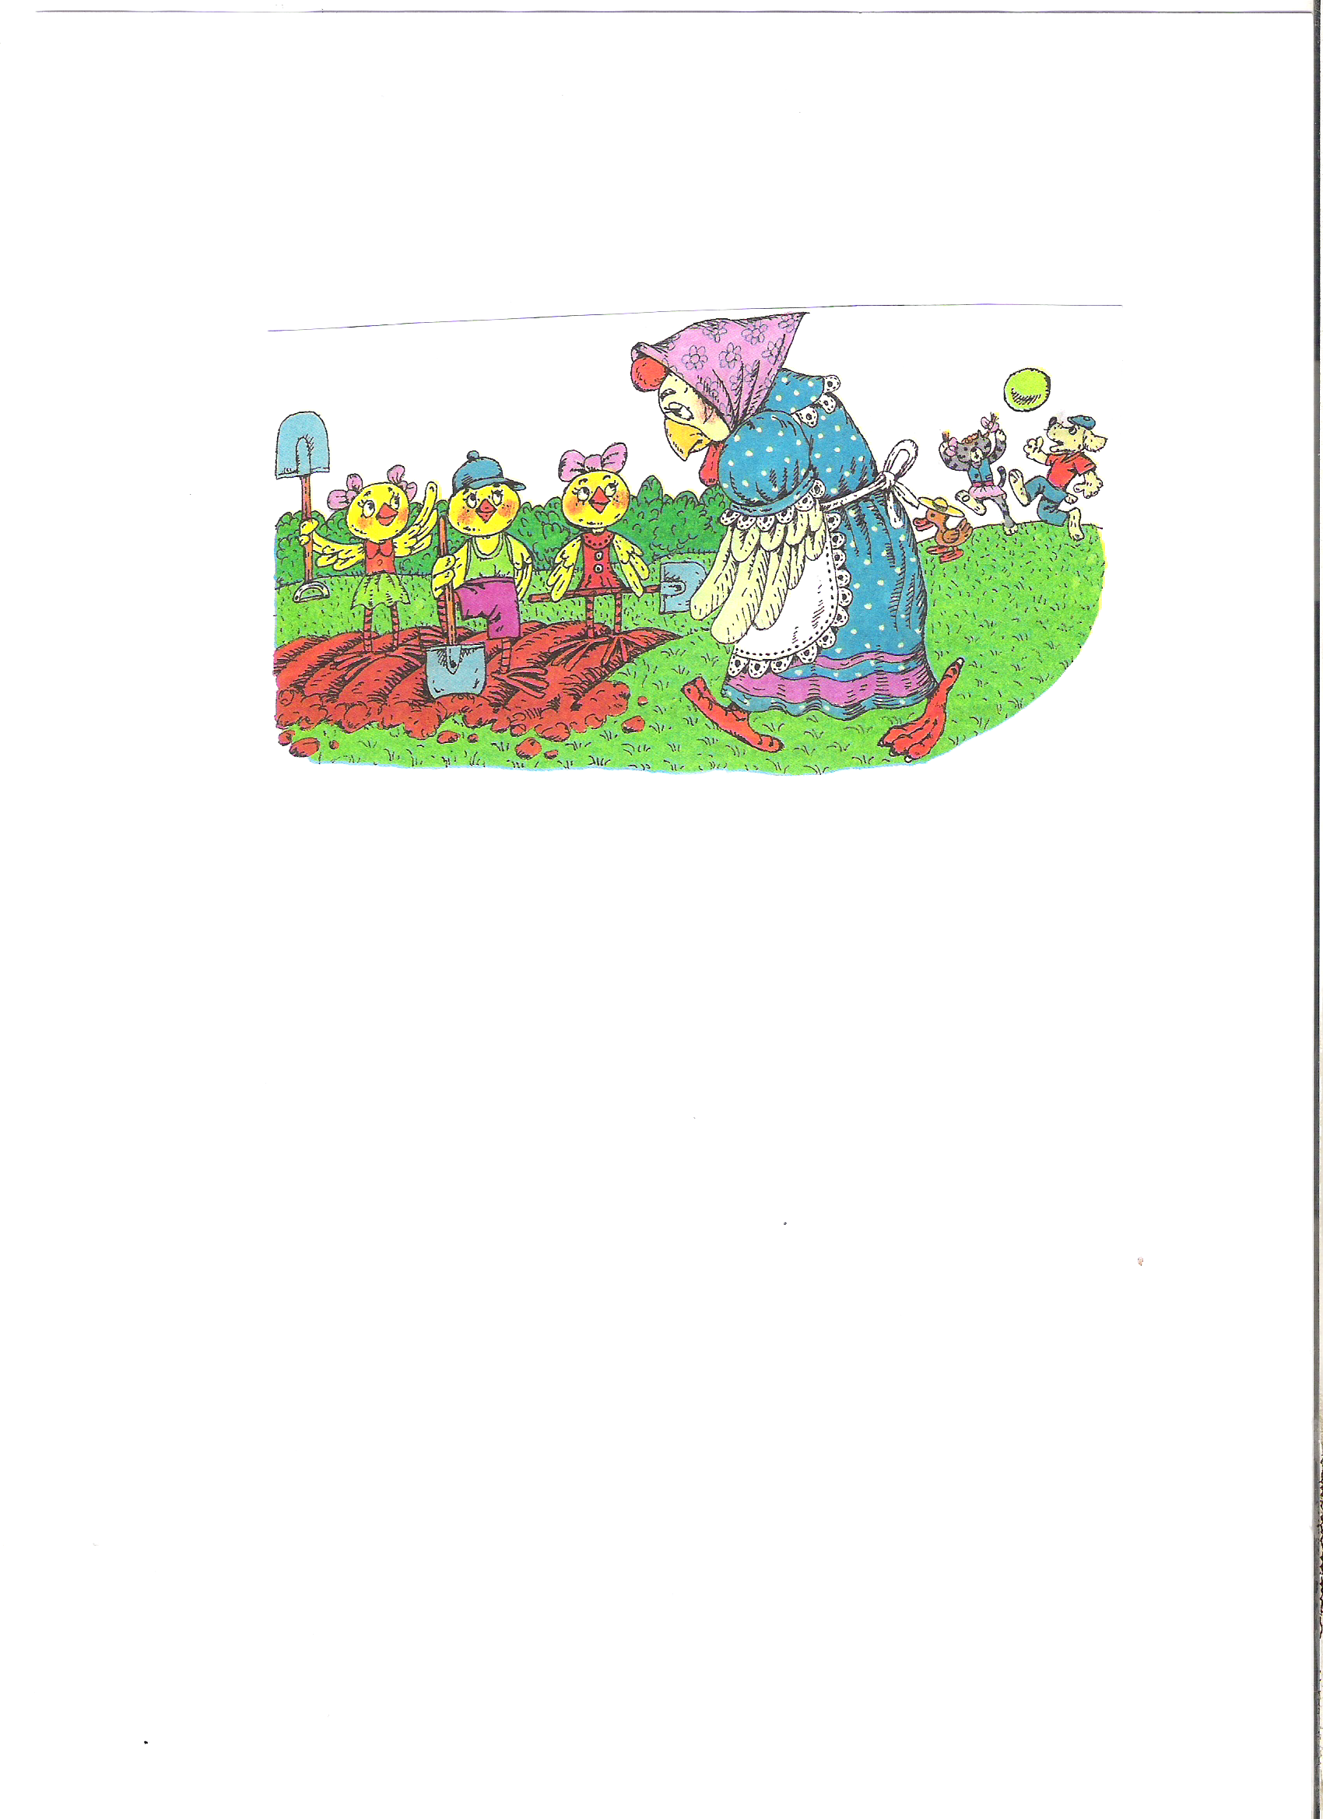
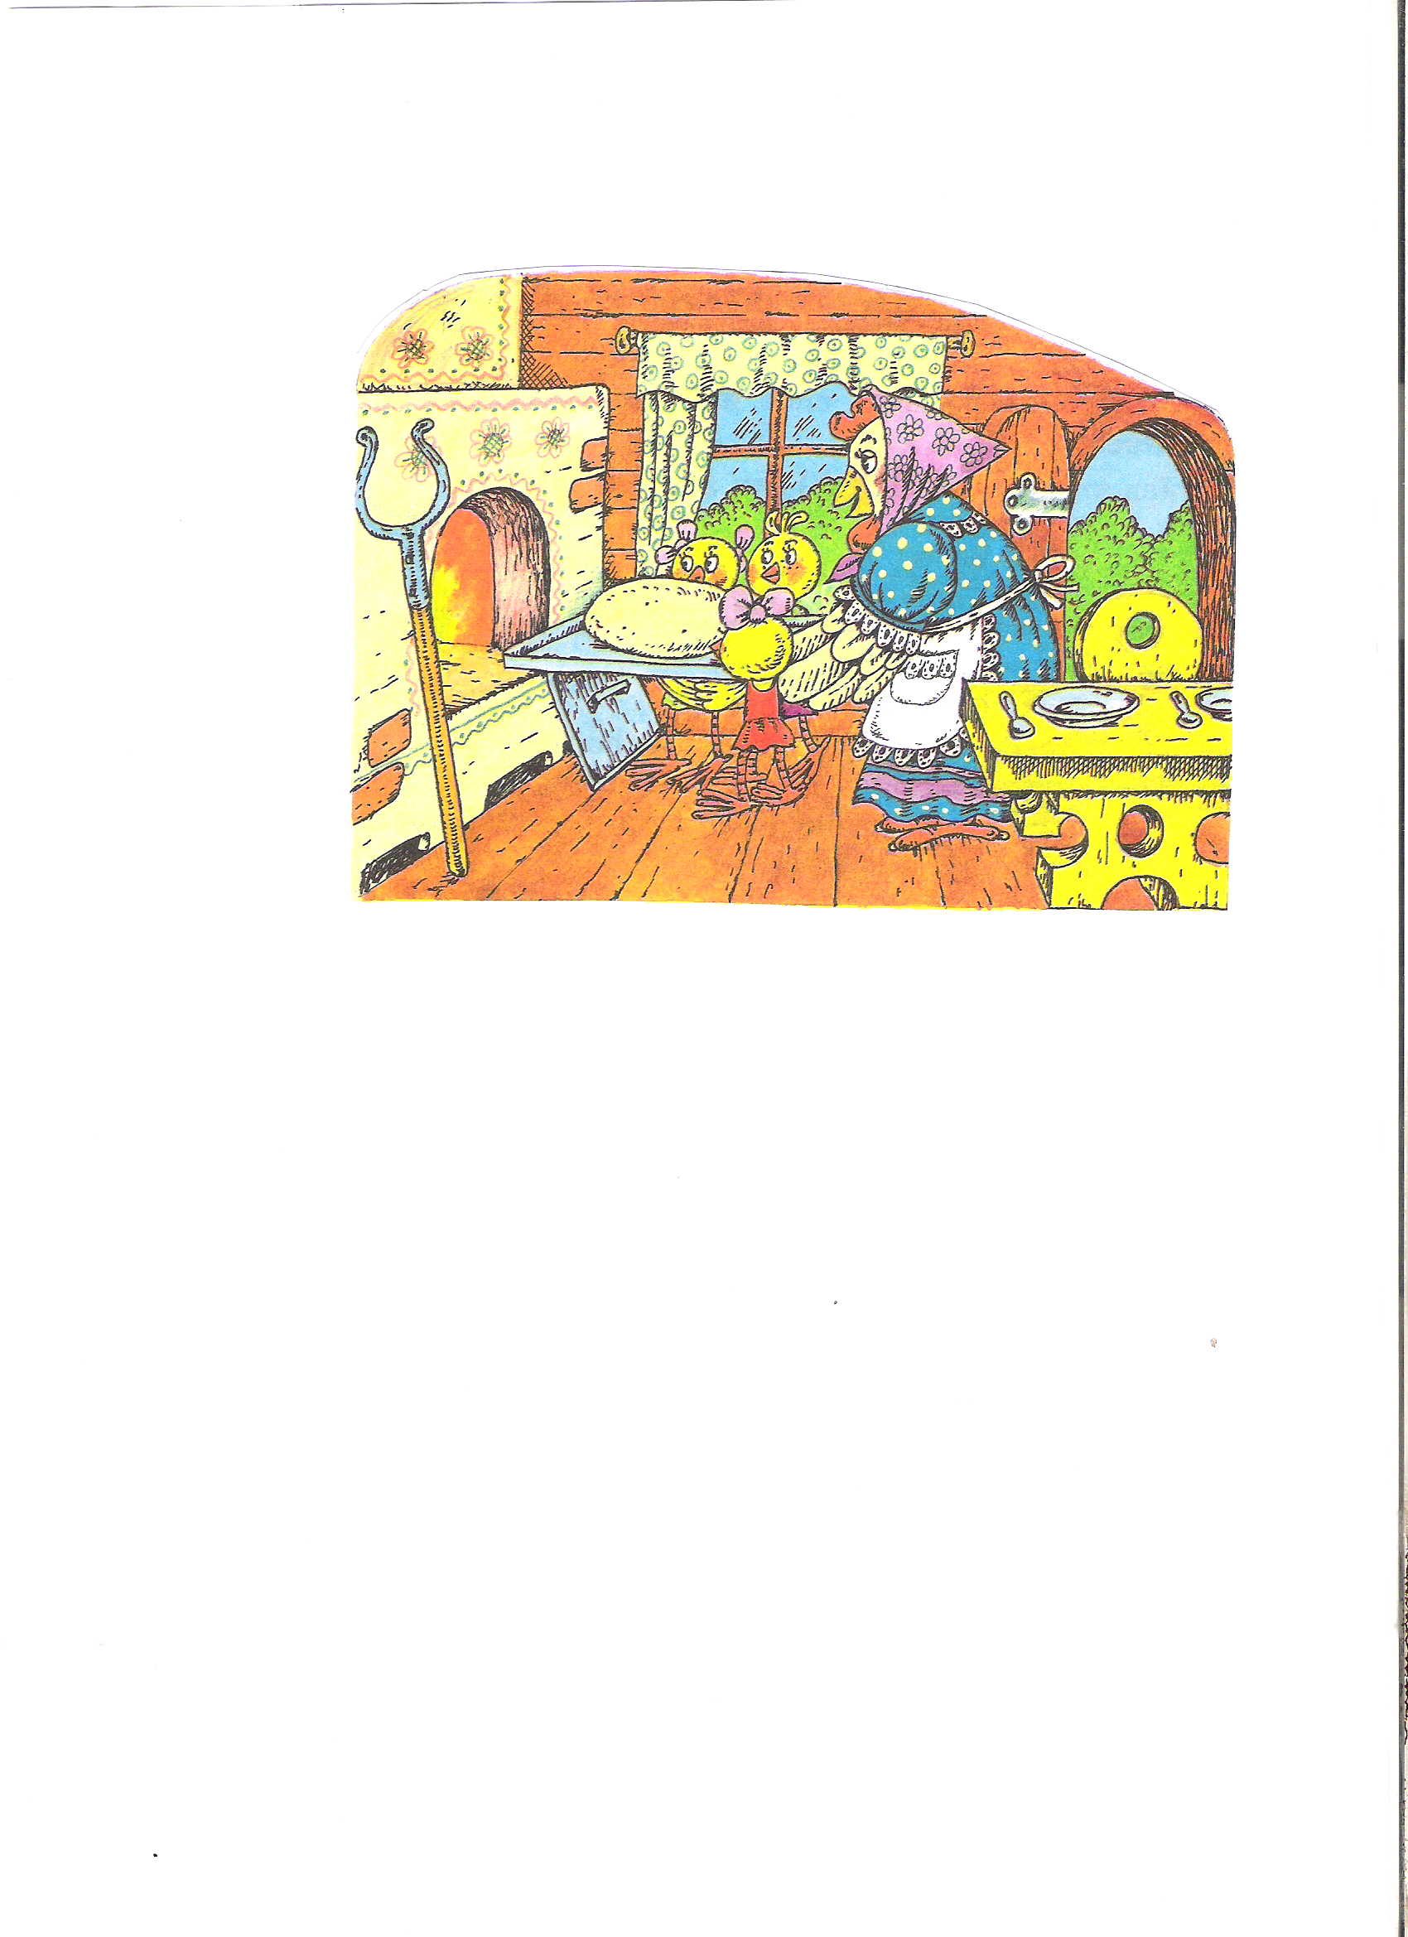
Make up a story

Slide 25
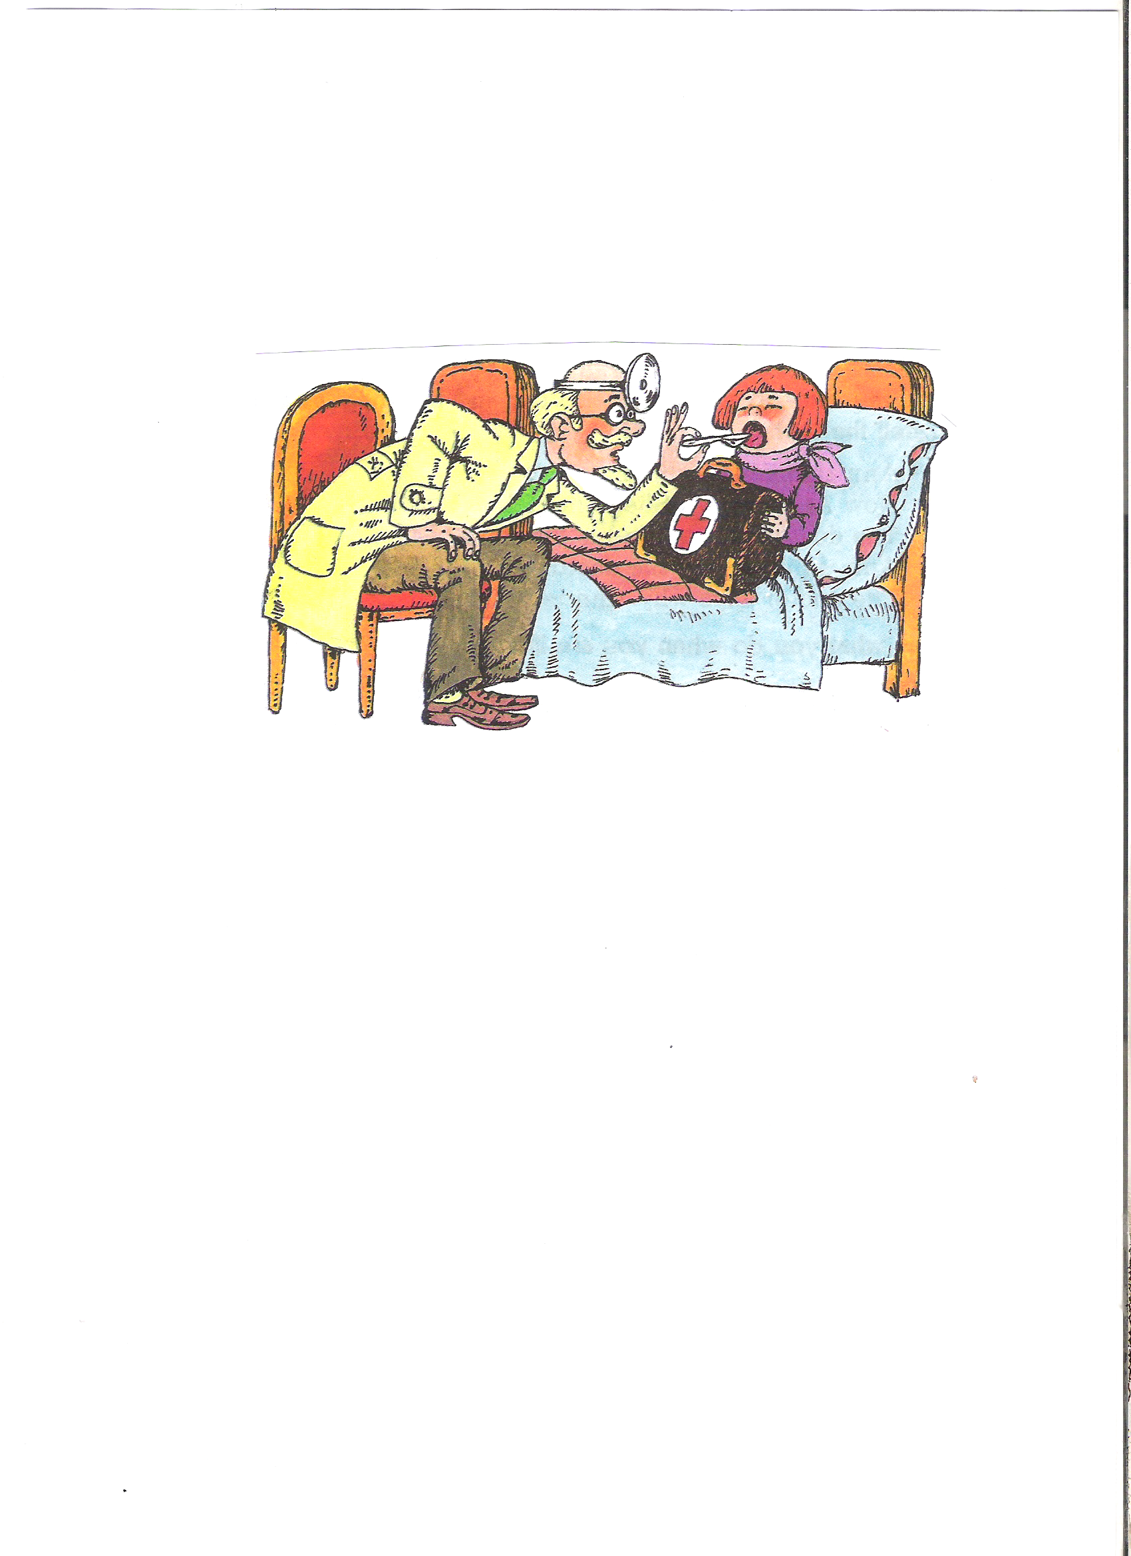
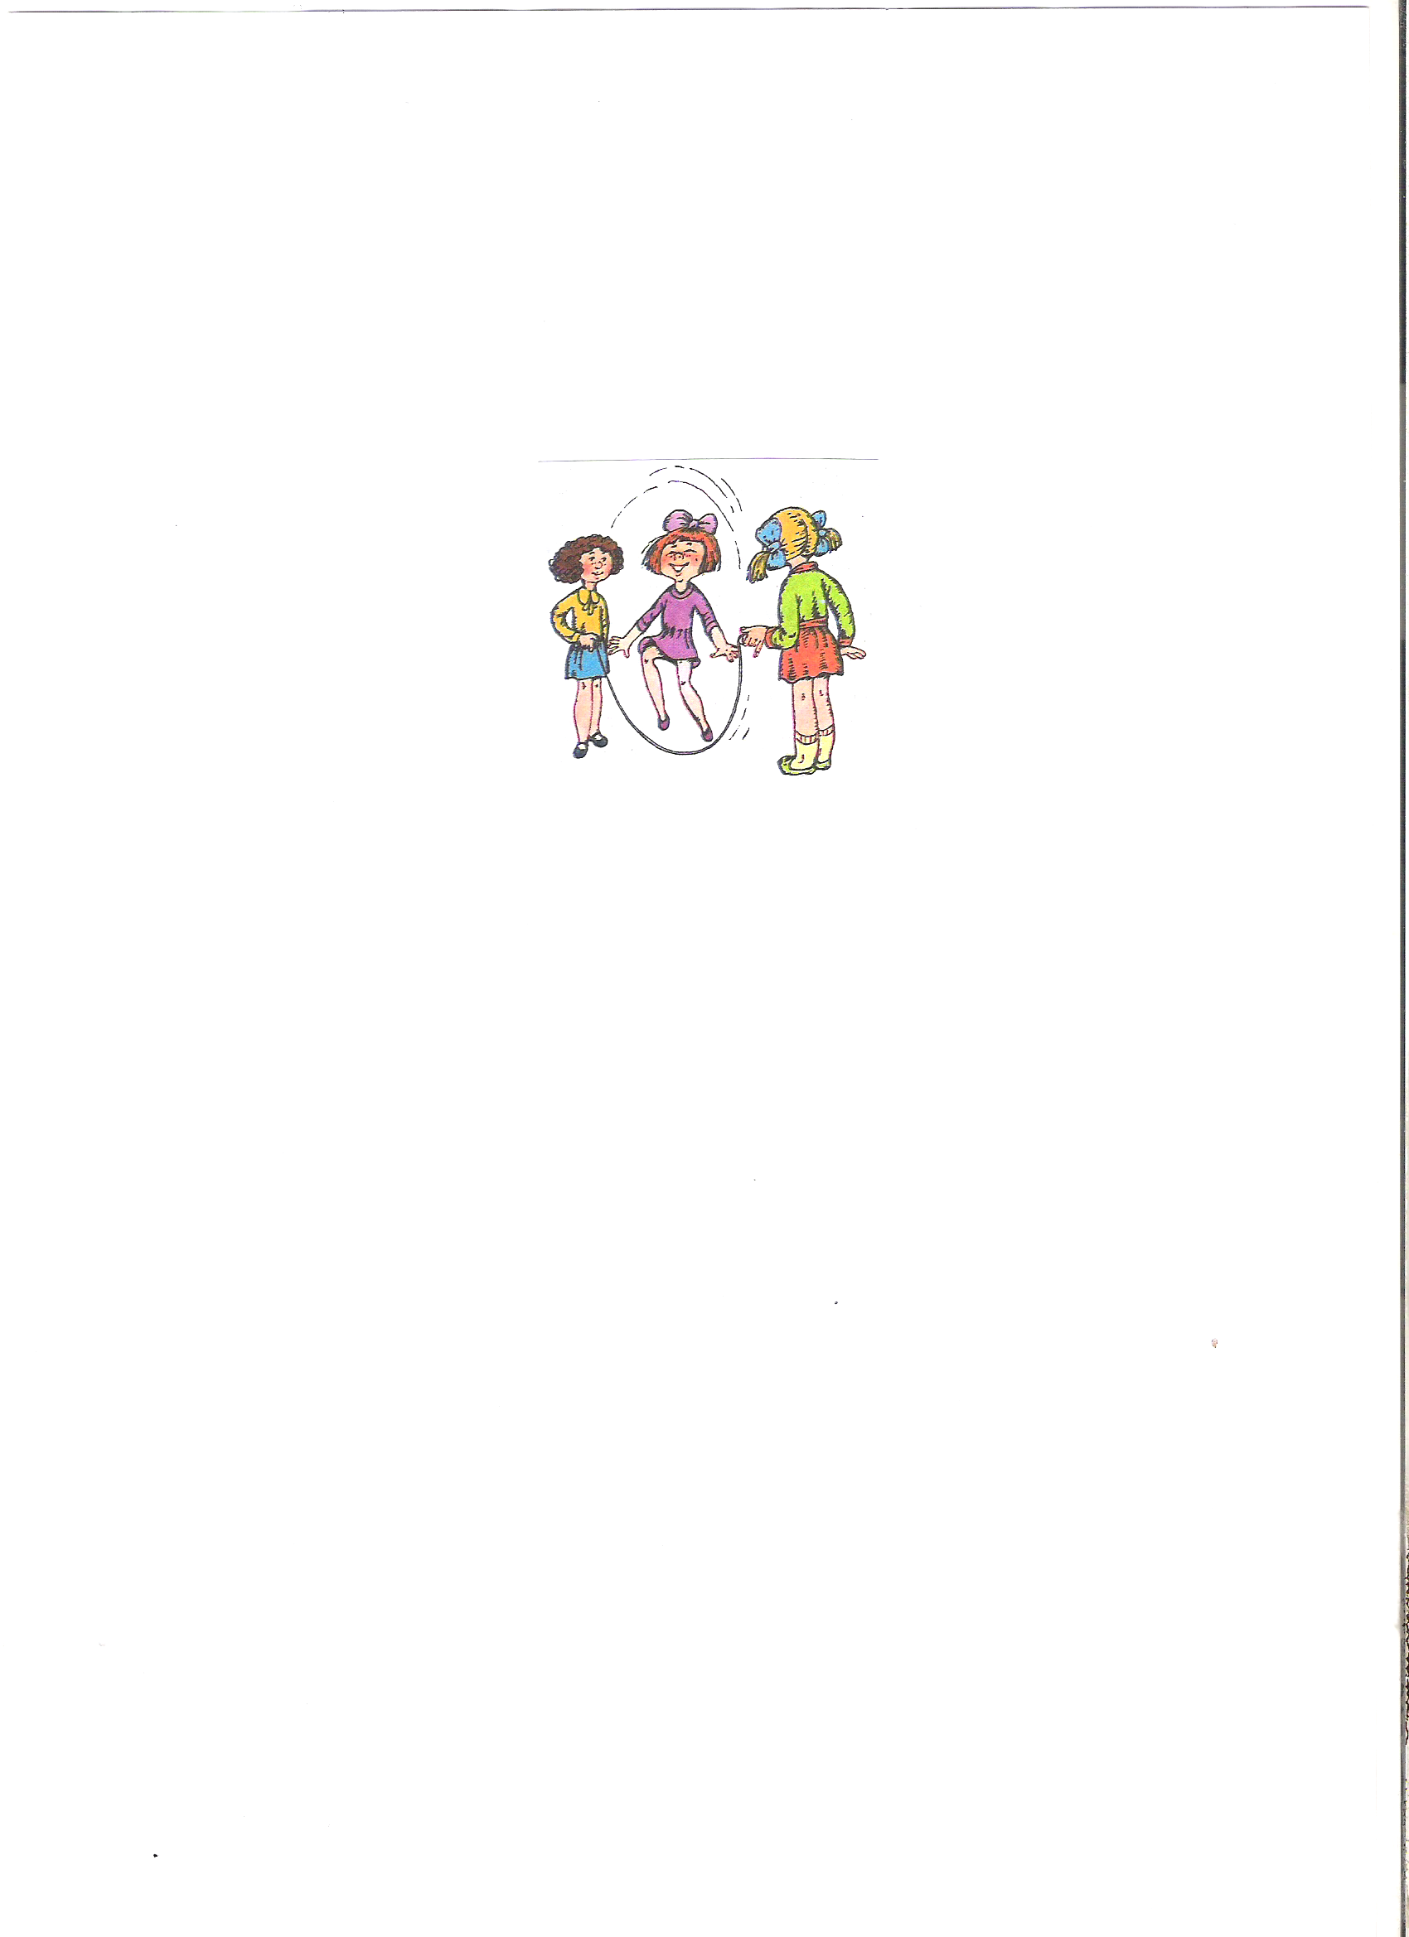
Make up a story

Slide 26
MERRY TRAIN

